Slide 1

Group No. : S9 - 4
RFID & RF Based E-Voting System
Presented By:-
1. Tejas Kole – E2301
2. Harsh Kolhe – E2302
3. Tejas Kotgire – E2304
4. Shraddha Kshirsagar – E2306
Guided By:-
Prof. Archana Deokate
Department of Electronics & Telecommunication Engineering
Smt. Kashibai Navale College of Engineering, Pune - 41.

Slide 2
CONTENTS
Aim and Objectives
Abstract
Literature Review
Introduction
Block Diagram
Circuit Diagram
Results
References

Slide 3
AIM
To develop an electronic voting system using RFID and RF modules for secure and contactless voting.
To utilize the ESP32 microcontroller for processing and WiFi-based connectivity.
To design a portable and compact hardware prototype integrated with buttons, LCD display, LEDs, and a buzzer.
To store voting data in real-time to Google Sheets via Apps Script Web App.
To eliminate manual errors, fake votes, and duplicate entries through RFID-based identification.
To enhance transparency, reliability, and efficiency in small-scale organizational elections.

Slide 4
OBJECTIVES
To uniquely identify each voter using RFID cards or tags, ensuring secure and authorized access.
To interface the RFID module (RC522) with ESP32 for card scanning and UID detection.
To integrate buttons representing different political parties (BJP, INC, AAP, NOTA) for casting votes.
To provide real-time feedback to voters using LEDs, buzzer, and a 16x2 I2C LCD display.
To enable vote casting timeout and invalid card handling using custom logic in Arduino code.
To implement master/admin RFID card functionality for ending voting and displaying the result.
To display vote summary and winner on both the LCD and send it to a Google Sheet via WiFi.
To prevent multiple voting from the same card by tracking already-voted users.
To improve user-friendliness with LCD instructions, countdowns, and error handling.
To demonstrate a functional prototype simulating real-time secure voting suitable for small-scale organizations.

Slide 5
ABSTRACT
• In today’s digital era, ensuring transparency and security in the electoral process has become increasingly important. This project presents an RFID & RF Based E-Voting System that aims to enhance voting reliability and eliminate the possibilities of fraud and repetition. The system uses RFID cards/tags to uniquely identify each voter and only allows authorized users to cast their vote.
• The core of the system is based on an ESP32 microcontroller, interfaced with components like an RC522 RFID scanner, push buttons for party selection, LED indicators, a buzzer, and a 16x2 I2C LCD for live feedback. Upon scanning, the system verifies voter identity, enables one-time voting through buttons, and sends the vote data in real-time to a linked Google Sheet via WiFi using HTTP requests.
• To enhance administrative control, a special Master RFID Card is used to end the voting session and display the final vote summary with the declared winner. The system also includes invalid card detection, already voted warning, auto timeout on inactivity, and visual feedback for each action.
• This project serves as a working prototype for secure, efficient, and tamper-free electronic voting — ideal for institutions, clubs, or internal organizational elections.

Slide 6
LITERATURE REVIEW
S.N. | Year | Title | Methodology
1 | 2017 | RFID-Based Electronic Voting Machine with Secure Access | Proposed a secure voting system using RFID cards to authenticate voters and restrict duplicate voting.
2 | 2019 | IoT-Enabled E-Voting System Using ESP32 and Cloud Integration | Integrated ESP32 with RFID and Google Sheets to store votes in real time and visualize data.
3 | 2020 | Multi-Level Authentication E-Voting System Using RFID & Biometrics | Combined fingerprint recognition with RFID card scanning to ensure high-level identity validation.
4 | 2021 | Secure RFID Voting System with Blockchain-Based Result Storage | Used blockchain ledger to store votes submitted via RFID-based validation, ensuring tamper-proof results.
5 | 2023 | Real-Time IoT-Based Voting with LCD Feedback and Remote Monitoring | Enabled live feedback via LCD and remote result monitoring using WiFi and cloud-based spreadsheets.

Slide 7
INTRODUCTION
• In today’s digital era, the need for modernization of conventional voting systems is crucial. Traditional methods involve manual registration, paper-based ballots, and physical counting, which are often time-consuming, error-prone, and susceptible to manipulation or malpractices. These limitations highlight the importance of building a secure, automated, and efficient voting mechanism.
• The RFID & RF Based E-Voting System is designed to address these challenges by leveraging RFID technology for voter authentication and ESP32 with WiFi connectivity to transmit and store votes in real-time to a Google Sheet. Each voter is issued an RFID tag, which when scanned, verifies their identity. Once verified, the voter casts their vote using dedicated buttons for each party. The system ensures that every user votes only once and prevents duplication through backend verification. Moreover, administrators can access real-time vote summaries and winner announcements, making the system transparent and auditable.
This smart system enhances reliability, reduces manual labor, eliminates the need for paper, and offers cloud-based storage — making it ideal for institutions, organizations, or small-scale elections.

Slide 8
INTRODUCTION
»» Why ?
• To eliminate manual errors and improve the accuracy of vote recording.
• To prevent fraudulent voting, such as double voting or unauthorized access.
• To enable real-time data logging and winner calculation on Google Sheets.
• To provide a cost-effective and portable solution for small-scale voting needs.
• To provide a cost-effective and portable solution for small-scale voting needs.
• To familiarize students with practical applications of RFID, IoT, and embedded systems.
• To introduce a modern voting system that is secure, fast, and eco-friendly.
• To demonstrate how technology can enhance transparency and trust in the election process.

Slide 9
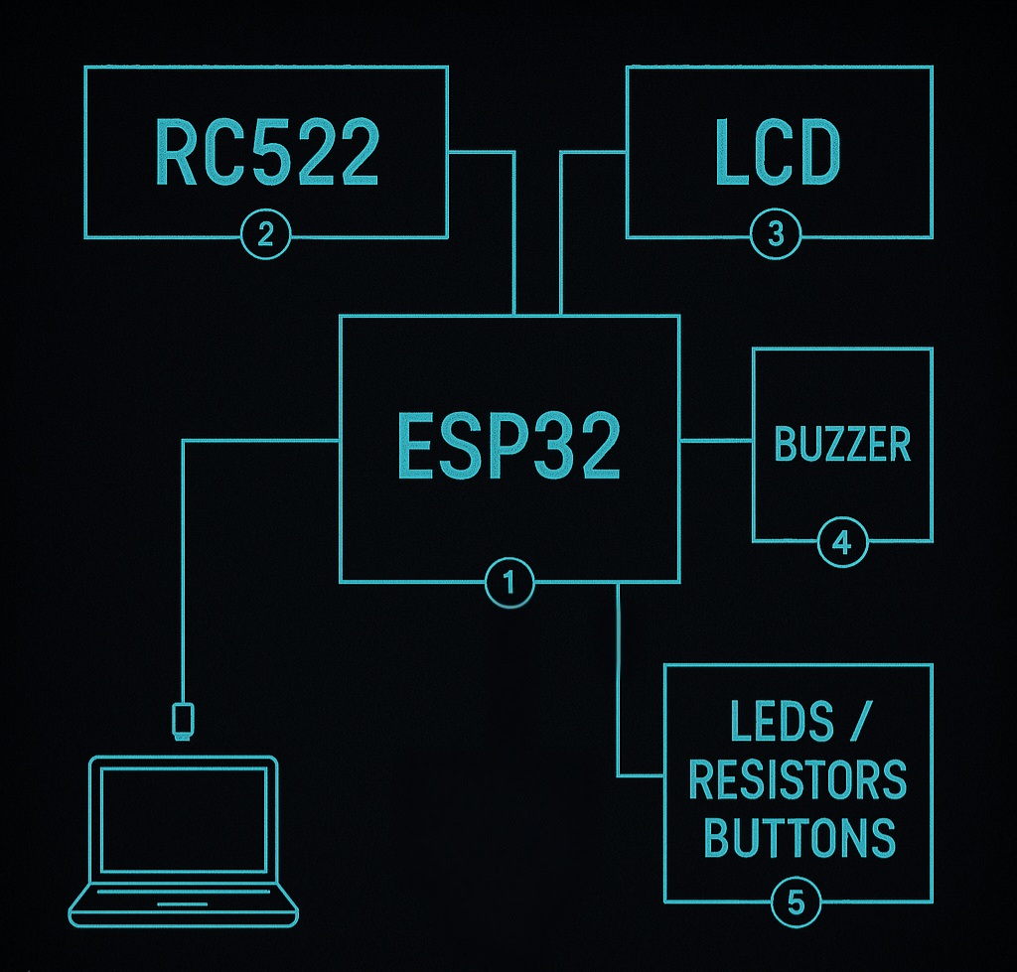
BLOCK DIAGRAM

Slide 10
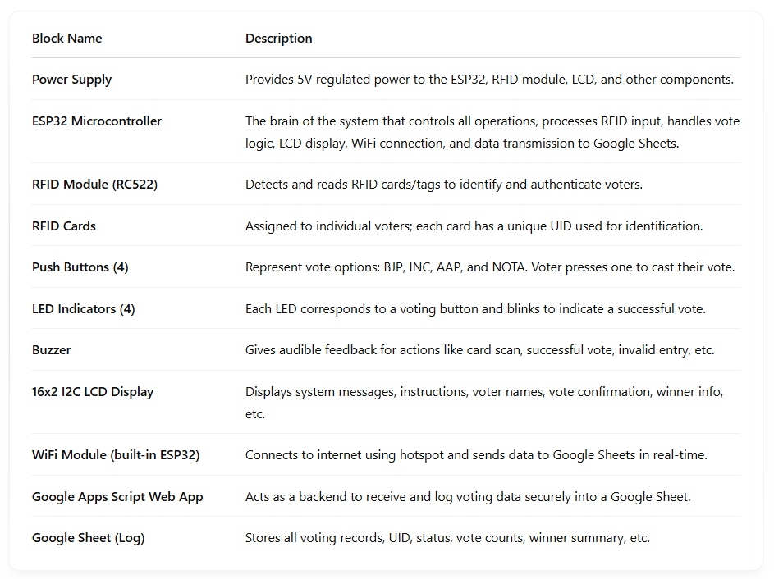
BLOCK DIAGRAM
Explanation / Table

Slide 11
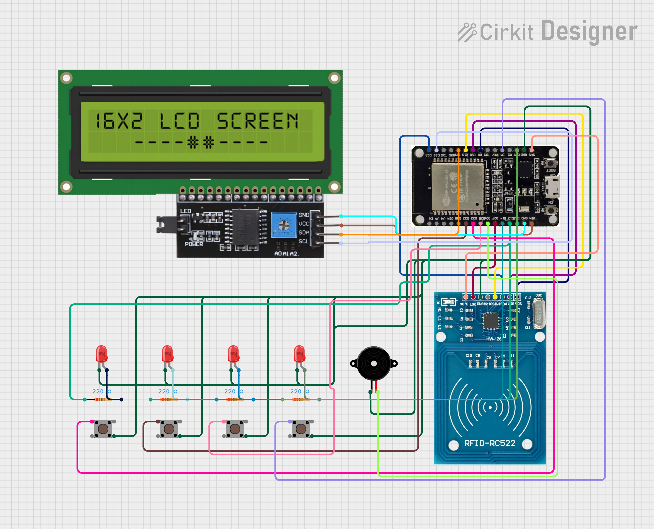
CIRCUIT DIAGRAM

Slide 12
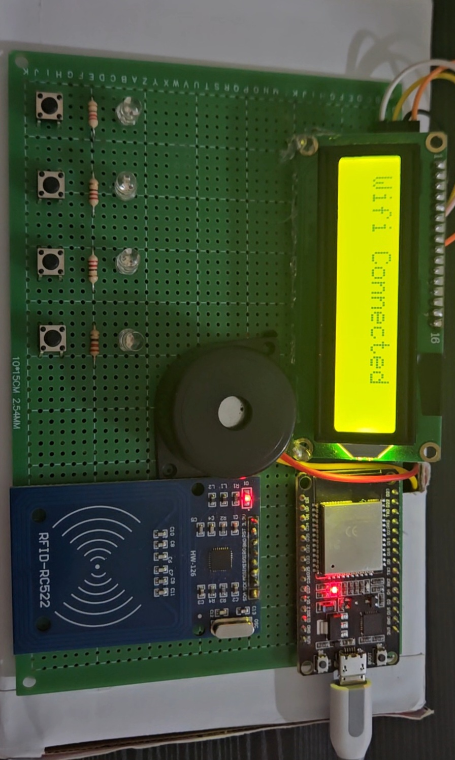
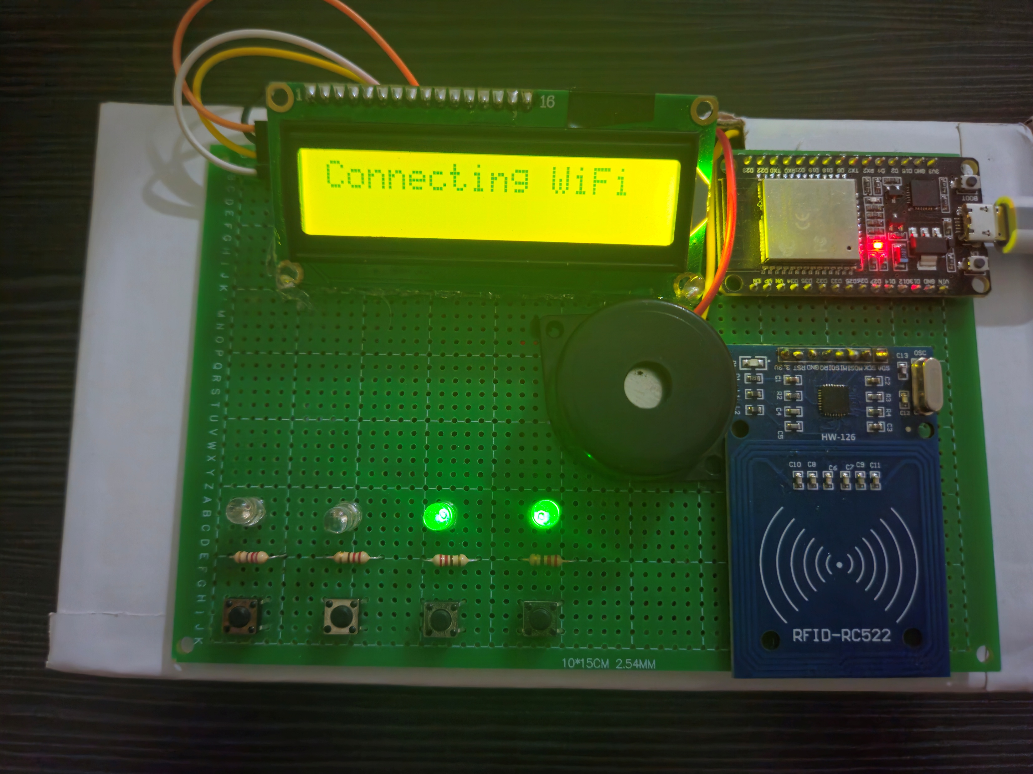
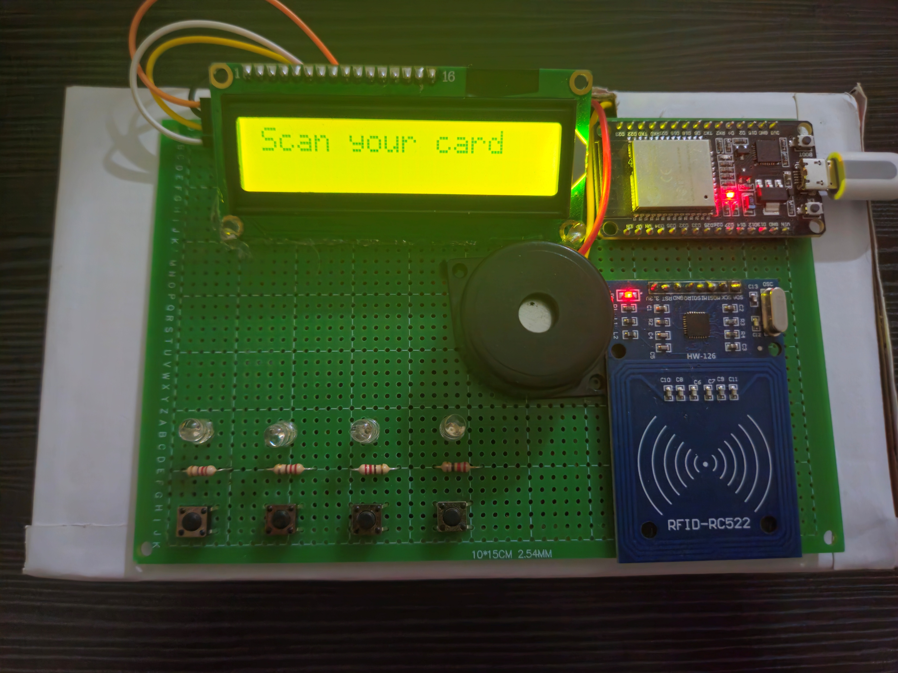
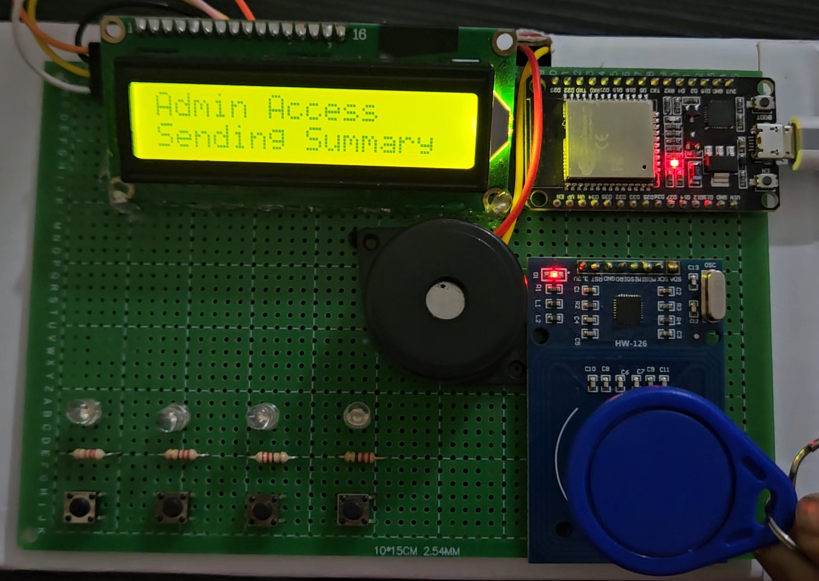
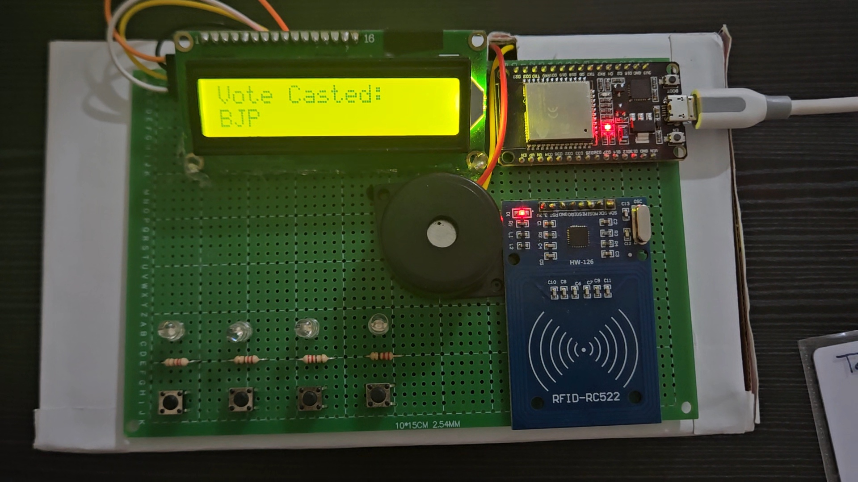
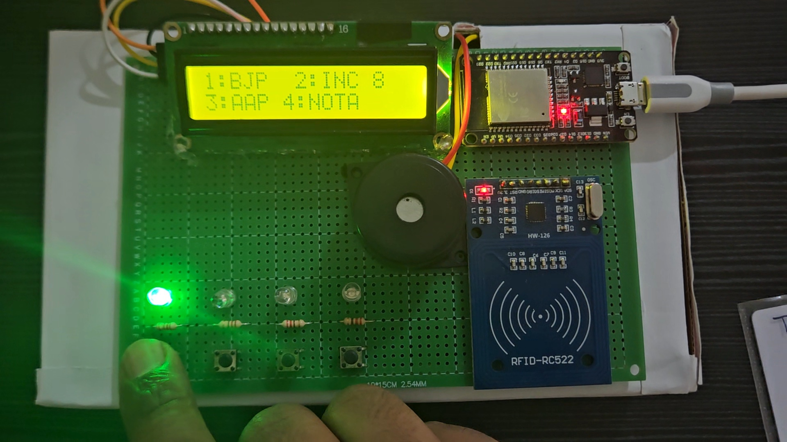
RESULTS
Working Images :

Slide 13
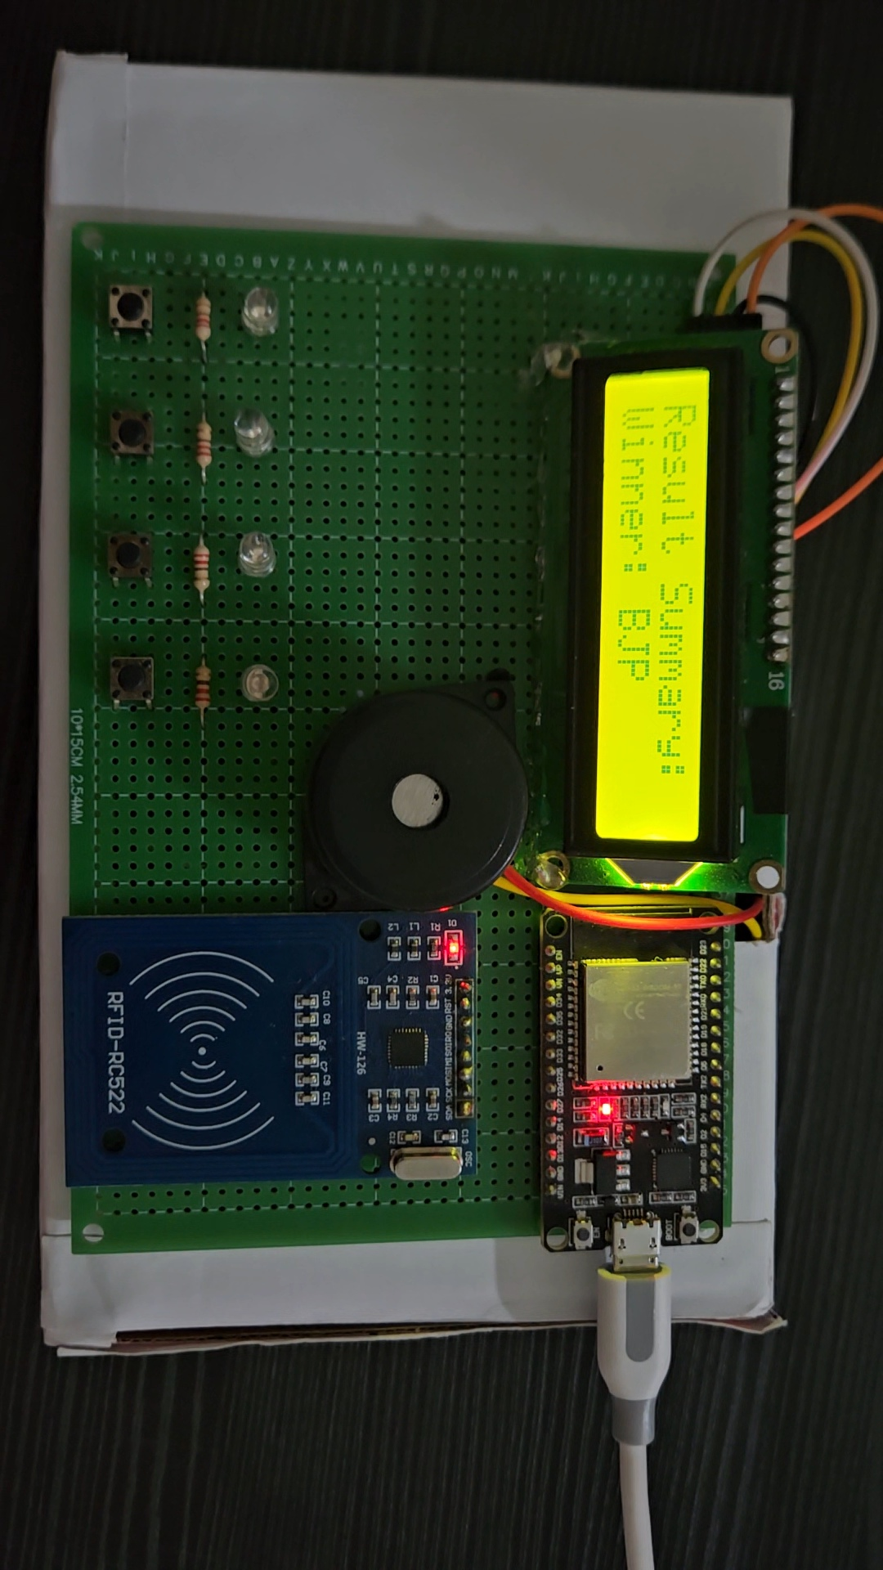

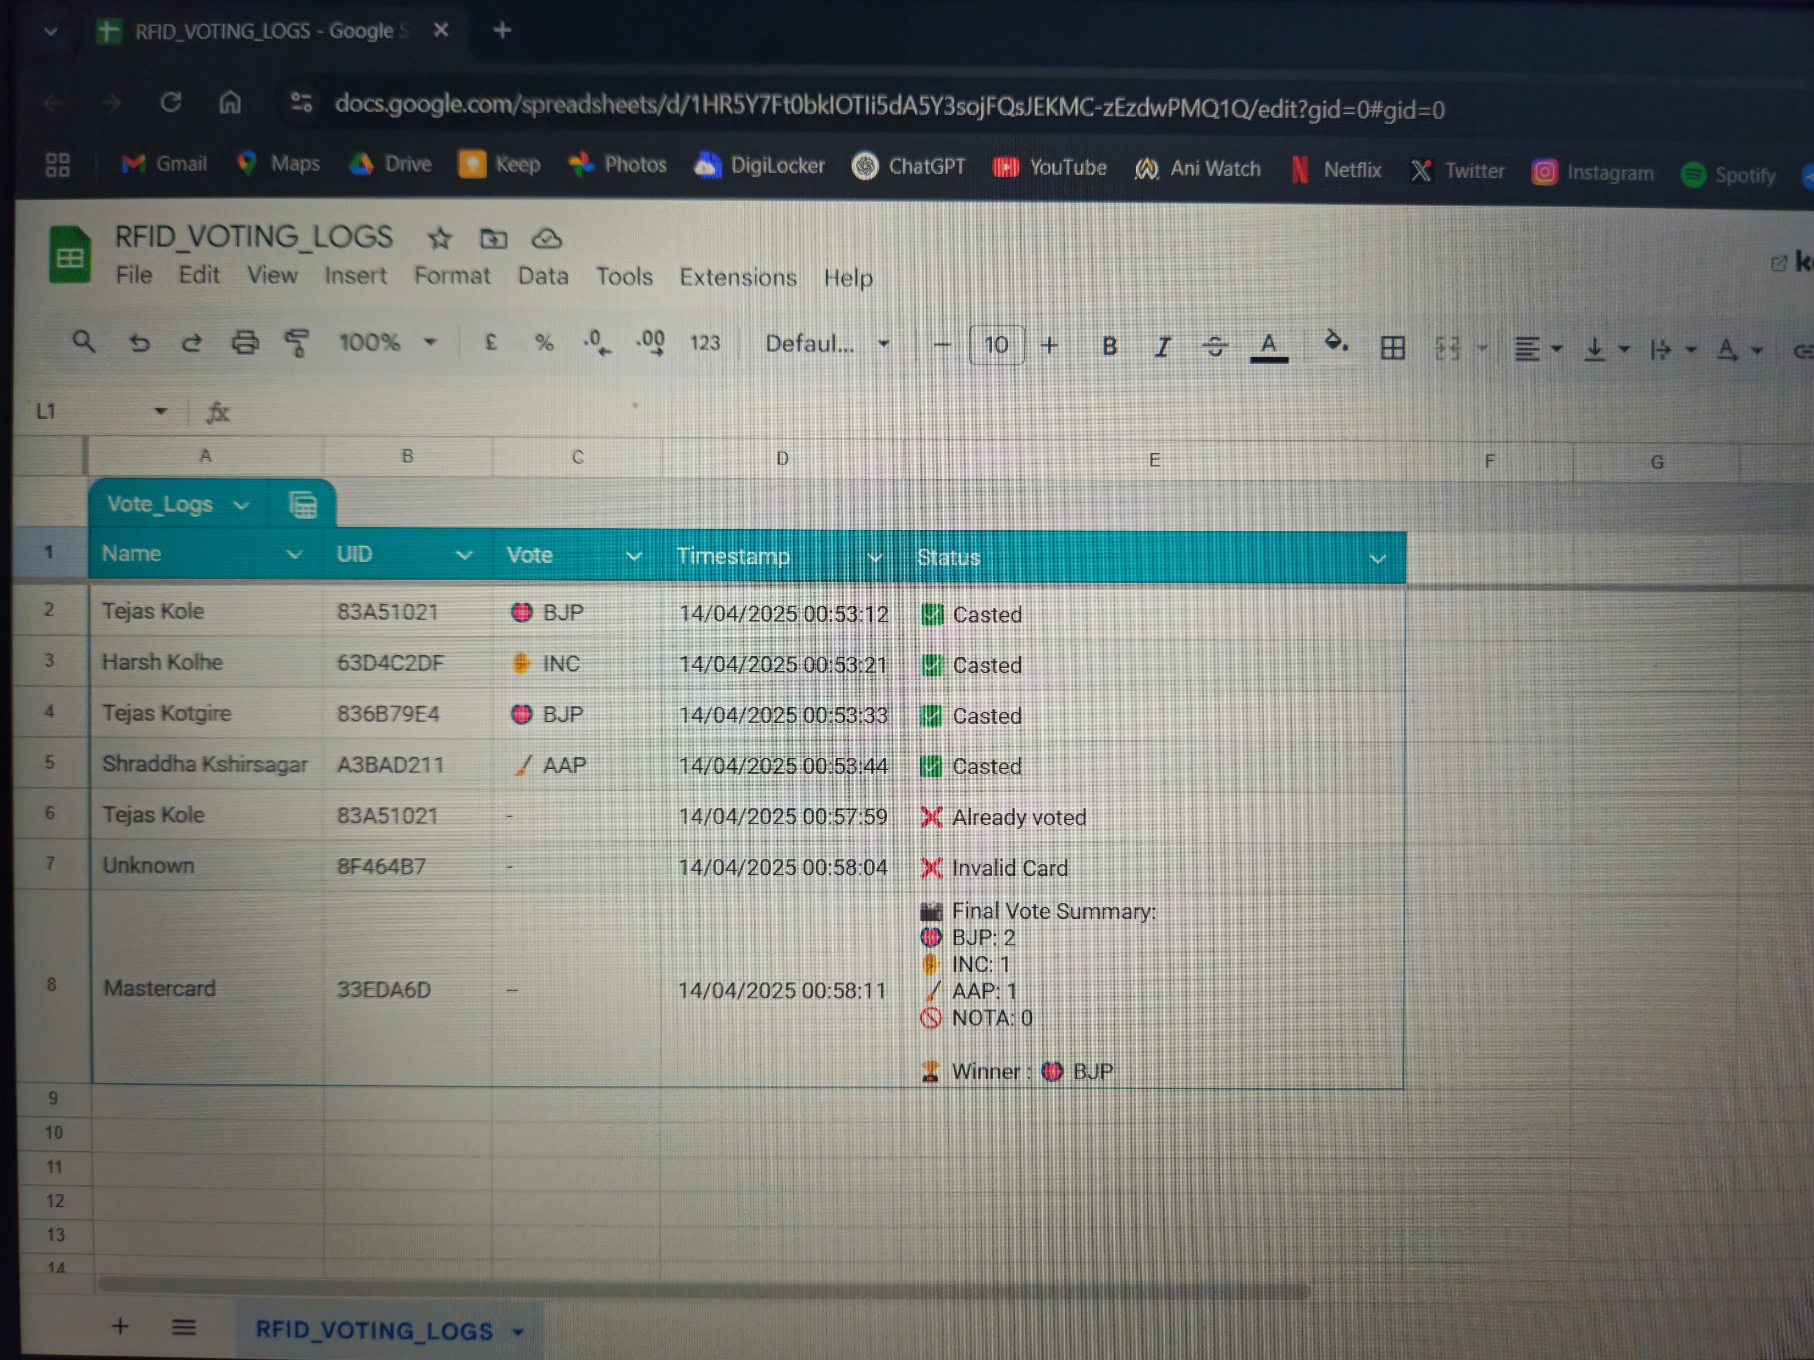
Github : https://github.com/TejasK-02/RFID-RF-Based-E-Voting-System
Youtube : https://youtube.com/shorts/w2tXMks05K4?si=k-z5knKSpe7Tq8rl
Drive : https://drive.google.com/drive/folders/1dlD695RuSaaR76-CfT7QR9z3M7TtpGgr

Slide 14
CONCLUSION
Voting is time-limited with a 10-second countdown, ensuring smooth flow and avoiding system hang-ups.
The RFID & RF Based E-Voting System successfully provides a secure, transparent, and tamper-proof voting mechanism.
Voters are authenticated using RFID cards, ensuring only registered users can cast their votes.
The system ensures one person, one vote, by maintaining a record of voters who have already voted.
Voting data, including party-wise vote count and voter details, are automatically updated to a Google Sheet for transparent logging.
A master RFID card allows administrators to view results, including total votes and winner, directly on the LCD and also logs it on the sheet.
The system handles edge cases like tie conditions, no votes cast, and invalid/unregistered RFID cards gracefully.
Voting is time-limited with a 10-second countdown, ensuring smooth flow and avoiding system hang-ups.
Visual (LEDs) and auditory (buzzer) feedback enhances user interaction and confirmation.
The system can be extended further with features like biometric authentication or IoT dashboard integration.
Overall, the project demonstrates how microcontrollers and real-time databases can be used to create smart, user-friendly, and efficient voting solutions.

Slide 15
REFERENCES
Rajeshwari Sundararajan, “Microcontroller based electronic voting machine,” International Journal of Engineering Science Invention, Vol. 2, Issue 2, 2013.
RFID Handbook: Fundamentals and Applications in Contactless Smart Cards, Radio Frequency Identification and Near-Field Communication by Klaus Finkenzeller.
D. L. Chaudhari, “Smart Electronic Voting Machine using RFID,” International Research Journal of Engineering and Technology (IRJET), Vol. 5, Issue 4, 2018.
MFRC522 RFID Module Datasheet by NXP Semiconductors.
Espressif Systems, “ESP32 Technical Reference Manual,” Version 4.0.
LiquidCrystal_I2C Library Documentation (Arduino.cc).
Google Apps Script Documentation (script.google.com).
Wireless Communications & Networks by William Stallings.
Arduino.cc Community Forums and Official Library Repositories.
IEEE Xplore Digital Library for papers on secure RFID-based systems.

